Slide 1


Slide 2
Problem Statement & Product Positioning
Most data failures and bugs are not caused by broken pipelines. They are caused by broken assumptions.
nvariant exists because data systems silently allow assumptions to drift; about schemas, semantic meanings, thresholds, and expectations, until something breaks in production.
When it breaks, teams discover the problem after impact has already occurred.
nvariant is designed to stop that.
Data Contracts exist in every modern-day organization as static, often stale documents. nvariant promotes these resources to living organisms.

Slide 3
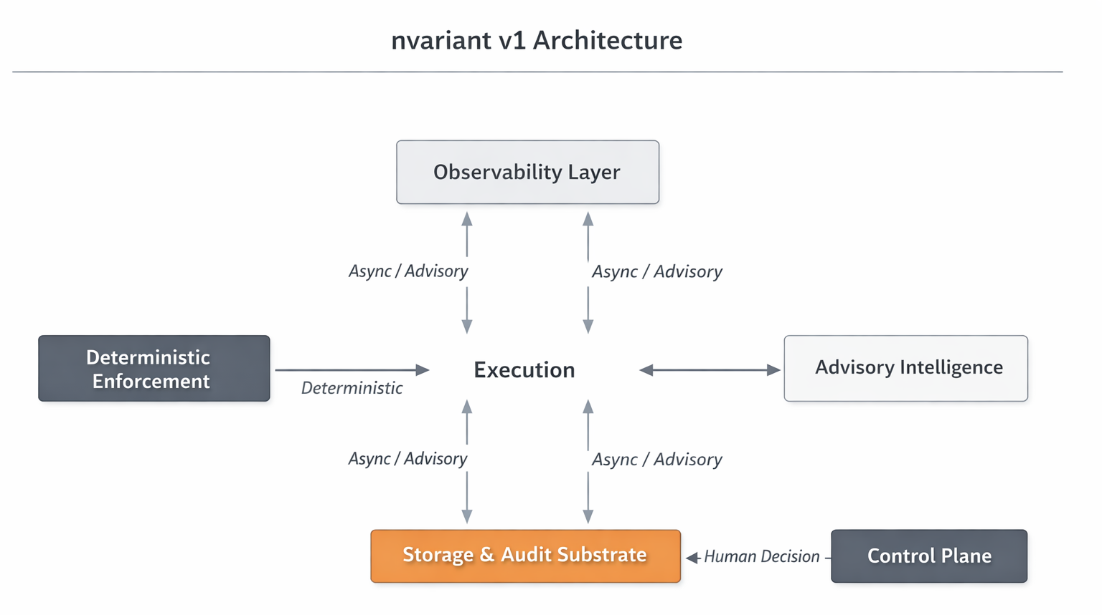
Architectural Map
nvariant is composed of a contract authority, a deterministic enforcement engine, a passive observability layer, an advisory ML system, and a human-centric explorer and control plane that together close the loop between intent, behavior, and governance.

Slide 4
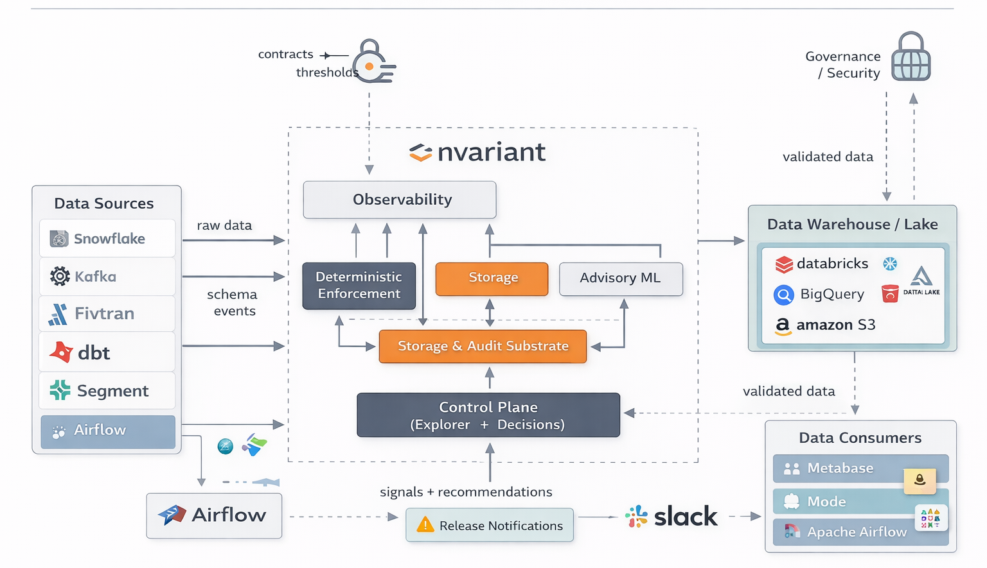
Enterprise Integration Overview
Invocation points
Source control / CI (pre-merge, pre-deploy)
Orchestrators (DAG deploy, task execution)
Transformation layers (model build, materialization)
Ingestion systems (publish checkpoints)
Scheduled observability loops

Slide 5
Technical Conceptual Summary
nvariant governs data by observing metadata-level behavior to establish baselines, capturing human intent as explicit contracts, enforcing those contracts deterministically at release time, and continuously monitoring production behavior for semantic and schema drift. Machine learning assists by proposing drafts, prioritizing signals, and suggesting evolution, but never exercises enforcement authority. All approved contracts, signals, overrides, and evolutions are traced across lineage and preserved in audit history, allowing governance to compound safely over time without interfering with data execution.

Slide 6
Core Unwavering Principles
Determinism enforces.
Observation informs.
Intelligence (ML) advises.
Humans decide.

Slide 7
User Journey

Slide 8
System onboarding and integrations
nvariant onboards by connecting read-only to your data platforms and CI/CD release surfaces, establishing identity, access, and asset discovery without altering production execution.
Surfaces: Control Plane (setup), integrations, credentials/roles, connectors
Output: known environments (dev/stage/prod), asset inventory, release hooks available

Slide 9
Asset discovery and inventory
nvariant discovers and indexes governed data assets and their metadata into a canonical inventory that becomes the scope for contracts, lineage, and monitoring.
Surfaces: Control Plane inventory, Explorer entry points
Features: asset catalog, tagging/ownership, environment scoping

Slide 10
Contract Bootstrapping
nvariant bootstraps by passively extracting structural and behavioral metadata from existing data flows, building time-based statistical baselines that remain non-enforceable until explicitly promoted by a human.
Surfaces: Observation layer + Explorer profiles
Features: schema snapshots, null-rate trends, distribution/range baselines, category growth, freshness/volume patterns

Slide 11
System-proposed contracts
nvariant proposes potential contract definitions by synthesizing sustained behavioral metadata into draft expectations that remain non-enforceable until explicitly reviewed and approved by a human.
Surfaces: Explorer “Proposals” + diffs vs baseline
Features: suggested ranges, null thresholds, cardinality expectations, stability bands, suspected anomalies flagged as “don’t promote”

Slide 12
Human-authored contracts
nvariant allows humans to author data contracts directly as explicit, versioned declarations of intent, defining enforceable expectations independently of historical data behavior.
Surfaces: Explorer contract editor + Control Plane policy scaffolding
Features: field meaning/definitions, required/optional, allowed values, thresholds, SLAs, ownership, severity

Slide 13
Contract review and promotion
nvariant transitions expectations from observational reference to enforceable authority by requiring human review, explicit promotion, and versioned publication of contracts.
Surfaces: Explorer review workflow + approval history
Features: per-rule accept/edit/reject, version notes, effective date, rollout scope

Slide 14
Contract binding to assets and lineage scope
nvariant binds published contracts to specific assets and their lineage context, defining exactly where enforcement applies and how impact should be traced.
Surfaces: Explorer (contract → assets), lineage view, contract trace view
Features: apply-to (table/view/domain), upstream/downstream coverage, exceptions, environment targeting

Slide 15
Enforcement surface configuration
nvariant configures deterministic enforcement surfaces by attaching active contracts to release-time checkpoints, ensuring violations can be detected before deployment.
Surfaces: Control Plane enforcement policies + CI/CD integrations
Features: “block vs warn,” severity mapping, required checks, allowed break-glass, policy per environment/team

Slide 16
Pre-release evaluation
nvariant deterministically evaluates proposed schema and semantic changes against active contracts at release time, generating a pass/fail decision with machine-verifiable reasons.
Surfaces: PR checks, build output, Control Plane “Release Gates,” API responses
Features: schema compatibility checks, required fields, type changes, semantic thresholds, known-safe evolutions, explicit diffs

Slide 17
Blocking and developer feedback loop
nvariant blocks violating releases and emits precise, actionable failure evidence across developer surfaces, enabling fast correction without ambiguity or manual investigation.
Surfaces: CI logs, PR annotations, command-line output, Control Plane violation detail
Features: violation reason, exact field/rule, expected vs observed, suggested fix, link to contract + lineage

Slide 18
Approval to proceed
nvariant allows releases to proceed only when checks pass or an authorized human executes a policy-governed override that is recorded for audit and follow-up.
Surfaces: Control Plane approvals + audit trail
Features: role-based override, justification required, time-bound exemption, notify stakeholders

Slide 19
Production execution
nvariant allows approved pipelines to run normally in production without inline interception, ensuring governance never becomes a runtime dependency.
Surfaces: none required; this is an architectural property
Features: no data mutation, no inline proxying, no performance coupling

Slide 20
Continuous production observation (post-release monitoring)
nvariant continuously observes post-deployment data behavior by collecting time-indexed behavioral metadata, enabling detection of semantic shifts without enforcing or mutating production data.
Surfaces: Explorer monitoring views, Control Plane signals
Features: rolling windows, trend baselines, stability scoring, seasonality awareness (where configured)

Slide 21
Drift detection and classification
nvariant identifies and quantifies deviations between observed behavior and contractual expectations, classifying drift into explainable signal types rather than automatic production punishment.
Surfaces: Explorer “Signals/Drift,” alert channels (if configured)
Features: drift types (range shift, null surge, category explosion, distribution skew, freshness drop), severity, confidence, start time

Slide 22
Lineage attribution
nvariant traces deviations across lineage to identify likely origin points and downstream blast radius, connecting behavioral change to the pipelines and assets that propagate it.
Surfaces: Explorer lineage graph + contract trace
Features: upstream change correlation, propagation mapping, impacted consumers, “first bad node” hypothesis

Slide 23
Human triage and decision (bug vs intended change)
nvariant centralizes evidence so humans can decide whether a detected drift is a defect to fix, an acceptable evolution to codify, or a temporary anomaly to ignore.
Surfaces: Explorer signal detail + collaboration hooks
Features: assign owner, annotate, link incident/ticket, snooze/ack, escalation policies

Slide 24
Remediation path
nvariant supports remediation by pinpointing the violating rule and the responsible upstream change, enabling teams to correct pipelines or revert releases with minimal guesswork.
Surfaces: Explorer + enforcement logs + developer tooling links
Features: “what changed” diffing, before/after comparisons, reproducible evidence for PRs

Slide 25
Evolution path
nvariant proposes contract updates when deviations are sustained and intentional, generating human-reviewable diffs that preserve intent while reflecting the new operational reality.
Surfaces: Explorer “Proposed updates”
Features: suggested threshold changes, new allowed values, new columns, deprecations, phased rollout notes

Slide 26
Human approval and versioned contract evolution
nvariant evolves contracts only through explicit human approval, publishing a new version with traceable rationale and a controlled effective scope.
Surfaces: Explorer approvals + version history
Features: versioning, changelogs, effective dates, rollback to prior contract, partial adoption

Slide 27
Future enforcement
nvariant feeds approved contract versions back into enforcement surfaces, ensuring the next release is evaluated against the newly ratified expectations.
Surfaces: Control Plane policies + CI/CD gates
Features: automatic gate update to latest approved contract, environment-by-environment rollo

Slide 28
Audit, reporting, and governance
nvariant maintains an immutable audit trail of contracts, violations, overrides, approvals, and evolutions, enabling governance reporting without relying on tribal knowledge.
Surfaces: Control Plane audit logs + reporting exports
Features: who approved what, when it took effect, which releases were blocked/overridden, evidence retention

Slide 29
ML Advisory
nvariant applies machine learning as an advisory layer that analyzes observed metadata over time to surface likely anomalies, propose contract drafts, and prioritize human attention without ever exercising enforcement authority.

Slide 30
Subsystems

Slide 31
Language Inventory
Language / Format | Where
TypeScript | UI, backend, enforcement, observability, ML advisory
JavaScript (runtime) | Node.js runtime
SQL | Postgres + warehouse checks
React | Control Plane + Explorer
YAML | Config, contracts, deployment
JSON | Contracts, proposals, config
Bash | Ops, e2e, scripts
Dockerfile | Packaging

Slide 32
System Legend
Control Plane = author/review/approve contracts + see violations
Explorer = browse schemas + lineage + contract trace + context
Canonical Backend + Postgres = source of truth for versions, approvals, results, audit
Enforcement = deterministic gate (CI) + deterministic runtime checks (warehouse)
Observability = continuous monitoring that generates drift/incident signals
ML Advisory = proposes updates + prioritizes, but never blocks anything
control-plane-ui (web)
explorer-ui (web)
canonical-api (backend)
enforcement-ci (runs in CI, not “always on”)
enforcement-runtime / warehouse (scheduled/worker style)
observability (scheduled/worker style)
advisory-ml (worker style; still advisory only)
postgres (stateful; ideally managed)
optional: redis/queue (only if your workers use a queue)

Slide 33
Contract System
nvariant represents data contracts as explicit, versioned, human-readable declarations of intent that define meaning, expectations, and enforcement scope independently of runtime behavior.
What it ingests
Schemas (DDL, OpenAPI, protobufs, JSON schemas)
Metadata (column names, types, nullability)
Statistics (cardinality, distribution, freshness, volume)
Behavioral signals (row deltas, value ranges, entropy)
How
Connectors, agents, or hooks
CI/CD parsing
Runtime inspection
Warehouse queries
Streaming taps (Kafka / CDC)
Contracts contain:
Structural rules (schema, types, required fields)
Semantic rules (ranges, distributions, invariants)
Evolution rules (allowed additions, deprecations)
Severity mappings (warn vs block)
Owners & approvals
Effective time windows

Slide 34
Observation Layer
nvariant observes production data systems by continuously extracting structural and behavioral metadata into time-indexed summaries without accessing or mutating authoritative data rows.

Slide 35
ML Advisory
nvariant applies machine learning strictly as an advisory layer to analyze observed behavior, propose draft contracts, classify drift, and prioritize attention without exercising enforcement authority.

Slide 36
Enforcement Layer
nvariant enforces active contracts deterministically at release-time control points by evaluating proposed changes against declared expectations and blocking violations before production.
Where enforcement happens
CI/CD pipelines
Deployment gates
Schema migration steps
Data publishing boundaries
Streaming consumers
Downstream materializations
What it does
Compares proposed state vs active contract
Produces a deterministic verdict:
✅ Allowed
⚠️ Allowed with warning
❌ Blocked

Slide 37
Integration & Connector Layer
nvariant integrates with data platforms, orchestration systems, and CI/CD pipelines through read-only and policy-bound connectors that expose metadata and release checkpoints without altering execution.

Slide 38
Lineage & Dependency Graph
nvariant maintains a lineage graph that maps upstream and downstream dependencies across data assets, enabling impact analysis and root-cause attribution for detected deviations.

Slide 39
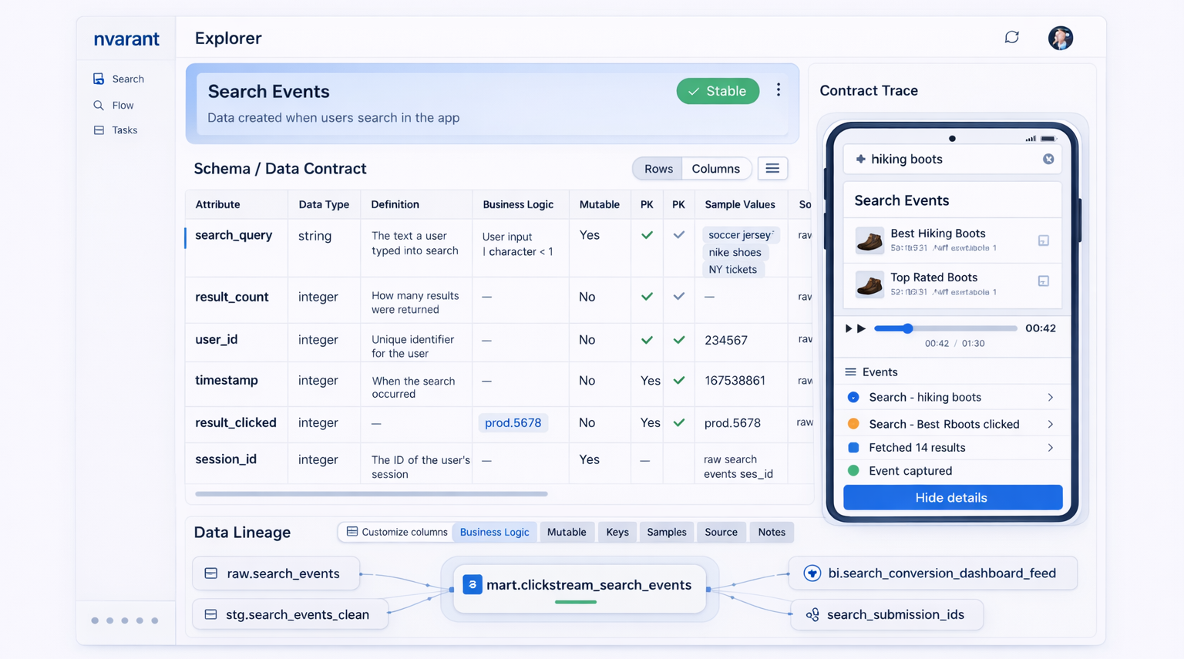
Explorer UI
Explorer answers:
What exists?
Where did it come from?
What contracts apply?
What changed over time?
What was blocked, when, and why?
Explorer shows:
Tables & schemas
Contract versions
Lineage graphs
Violation timelines
Drift deltas
Historical state
nvariant surfaces contracts, observations, drift signals, and lineage through a centralized Explorer interface designed to make data behavior intelligible without requiring code inspection targeted for non-tech audiences.

Slide 40
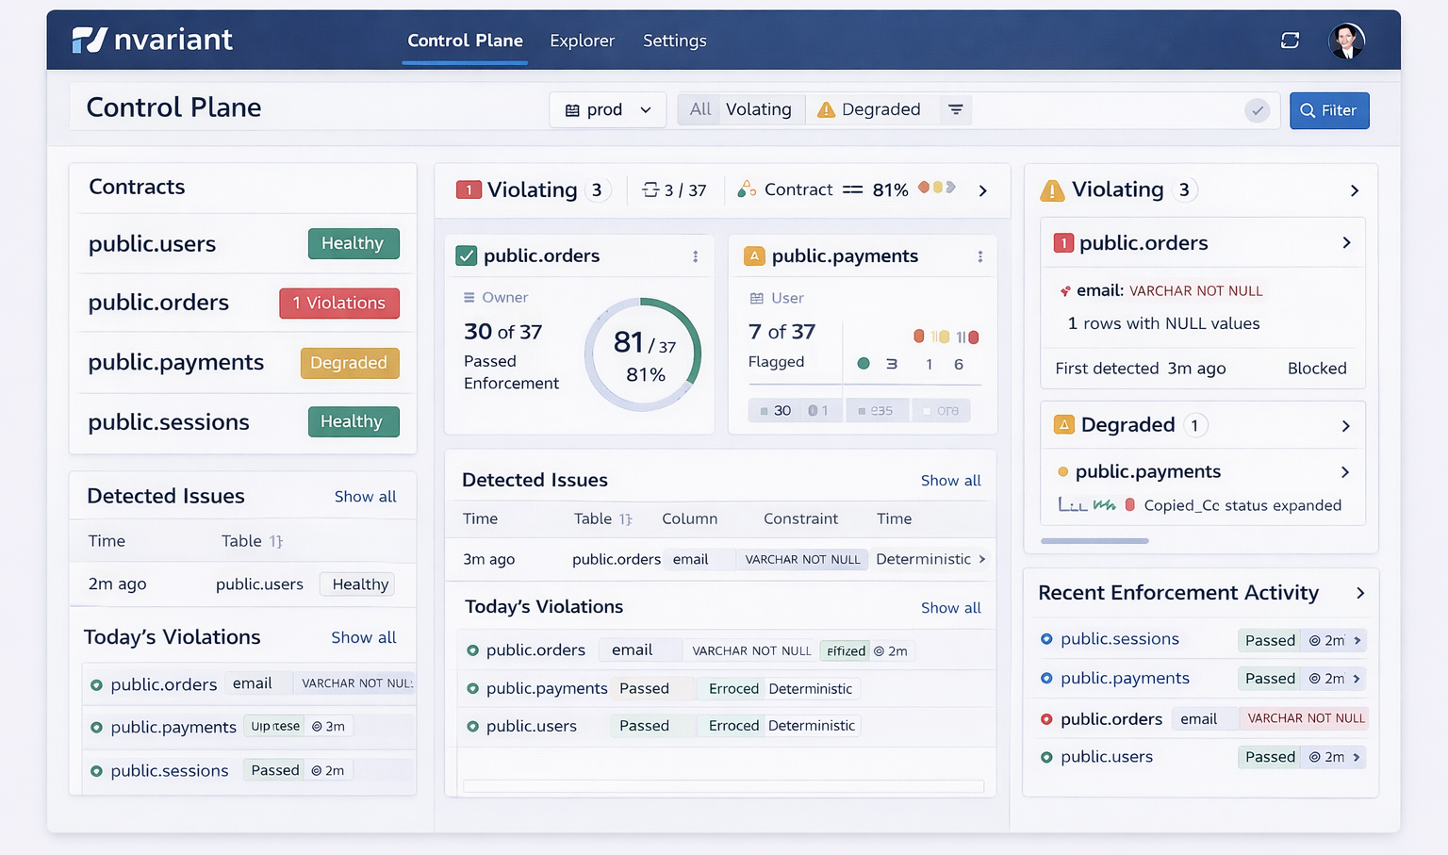
Control Plane UI
nvariant centralizes governance configuration, enforcement policies, approvals, overrides, and system state within a control plane that defines how and where authority is exercised.
Control Plane is where:
Contracts are authored
Rules are tightened or loosened
Exceptions are granted
Ownership is assigned
Enforcement policies change

Slide 41
Approval & Decision Workflow
nvariant routes contract promotion, overrides, and evolution through explicit human approval workflows that preserve accountability and intent at every governance boundary.

Slide 42
Audit & Evidence Store
nvariant records an immutable audit trail of contracts, violations, approvals, overrides, and evolutions to support compliance

Slide 43
Signal & Notification Layer
nvariant emits drift signals, violations, and advisory insights through configurable notification channels while separating informational alerts from enforcement actions.

Slide 44
Drift Glossary
Type | Example | Enforcement
Schema Drift | Column removed | Deterministic
Semantic Drift | Values shift meaning | Observed → flagged
Behavioral Drift | Volume/frequency change | Observed → alerted
Evolution | New nullable column | Allowed
Degradation | Gradual null creep | Advisory
Violation | Breaking change | Blocked

